Slide 1
Jason Liu Dev Portfolio

Slide 2
Introduction
Purpose of the project
How I approached it
What Difficulty I faced
How long it took
Why I chose my design
What did I not like about my design
What will I improve on next time

Slide 3
Features
Navbar
Home
Footer
Content pages
Animations
SRI Integrity
Scrollbar
Forms using Formspree
Media Queries

Slide 4
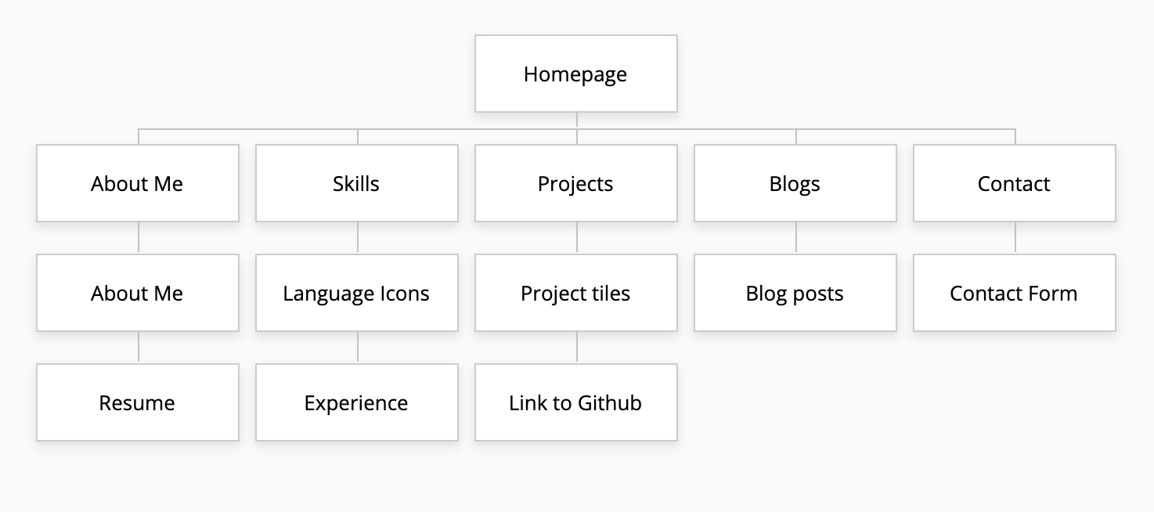
Sitemap for Portfolio

Slide 5
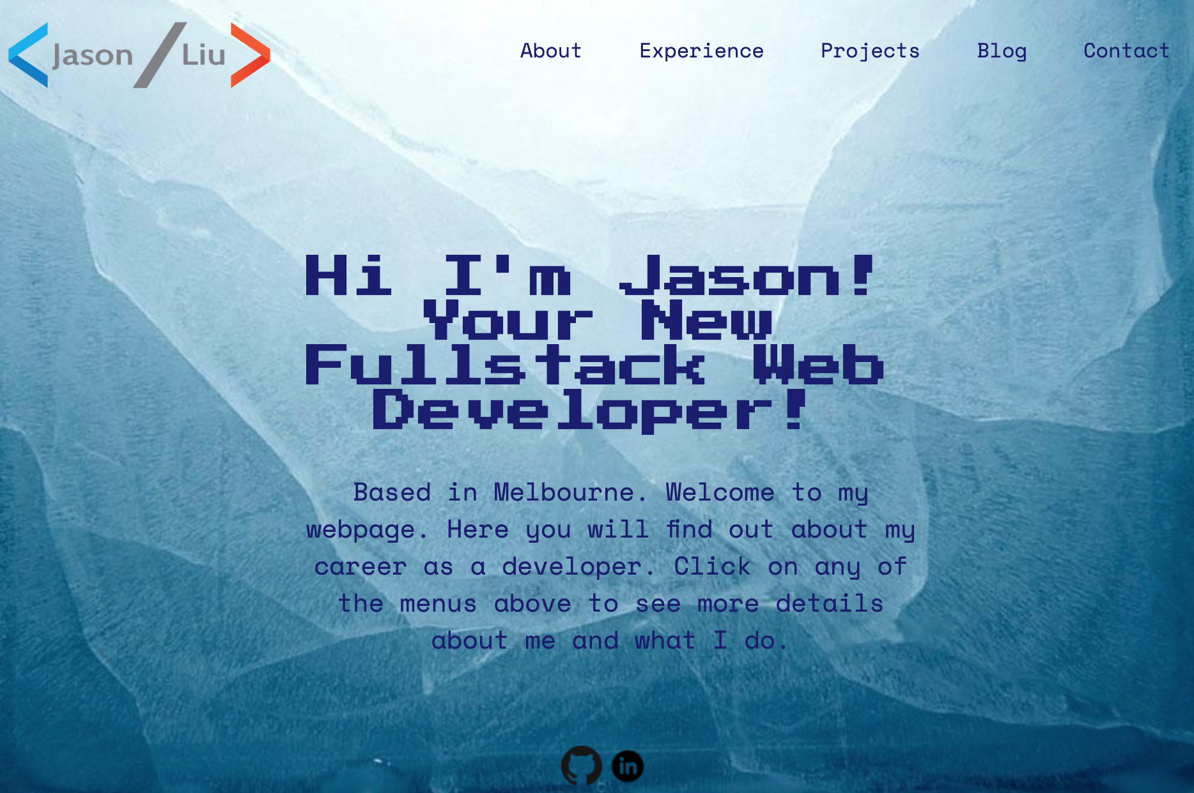
HomePage
Navigation bar
Logo
Container
Link

Slide 6
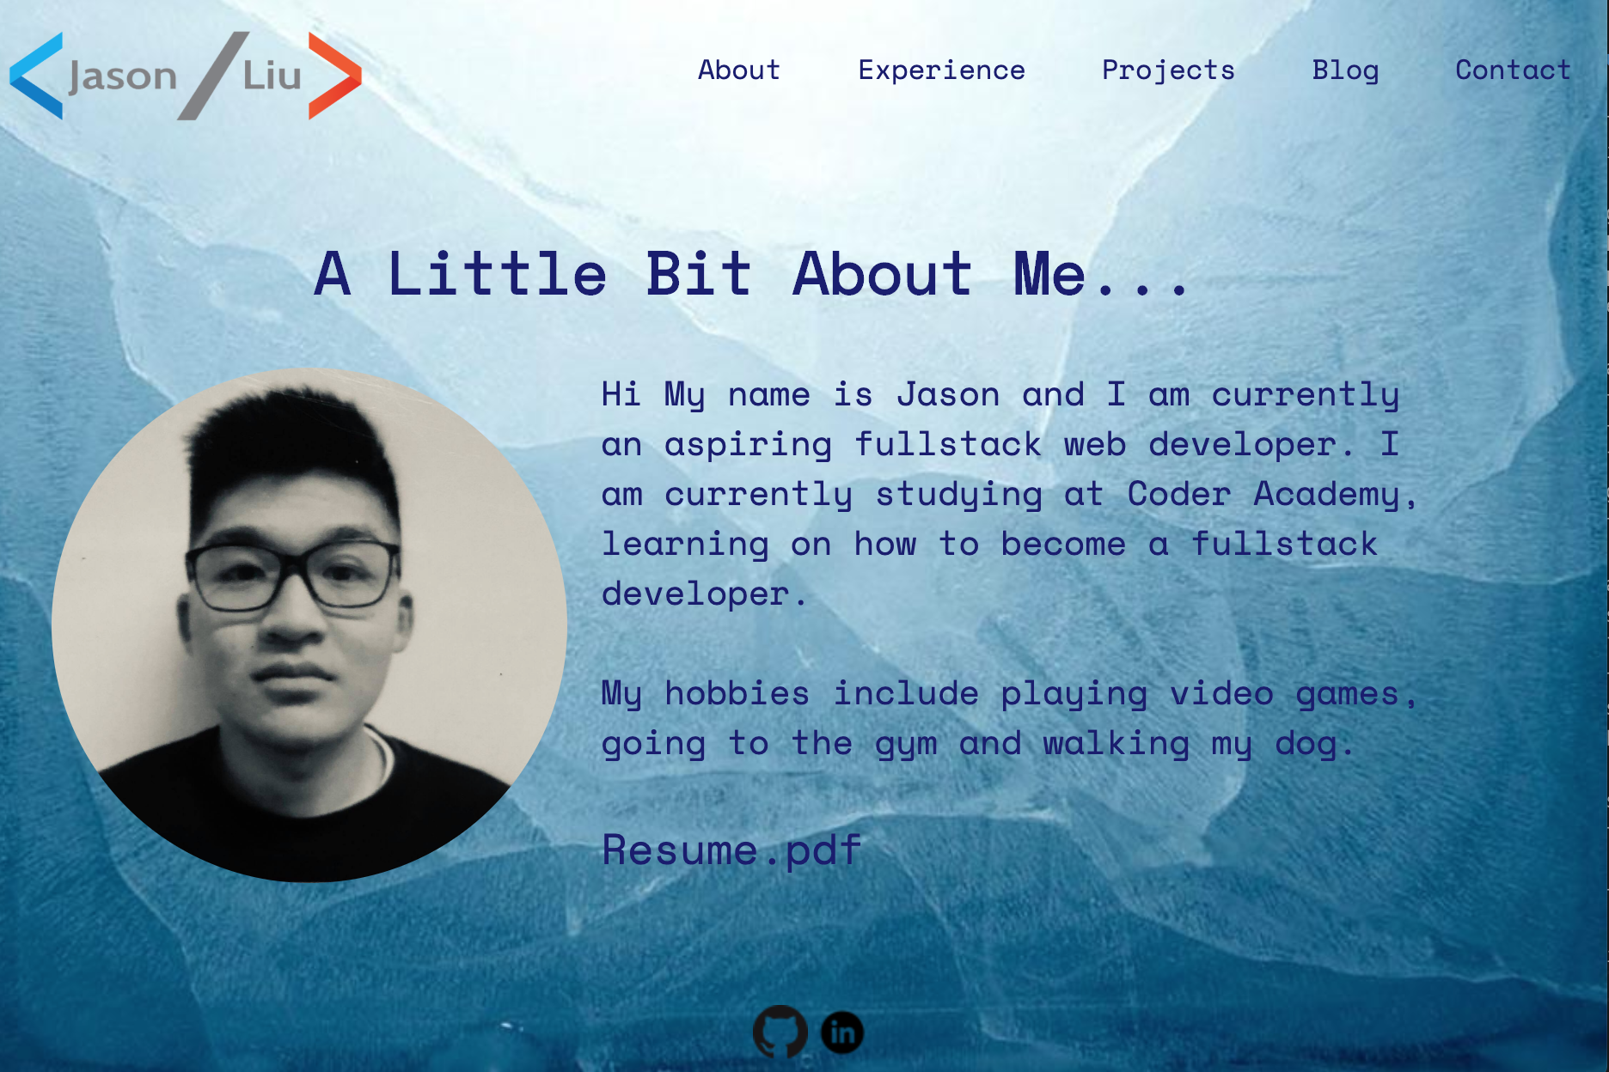
About Me Page
Logo
Heading
Navigation Bar
Image
Container
Link
Link

Slide 7
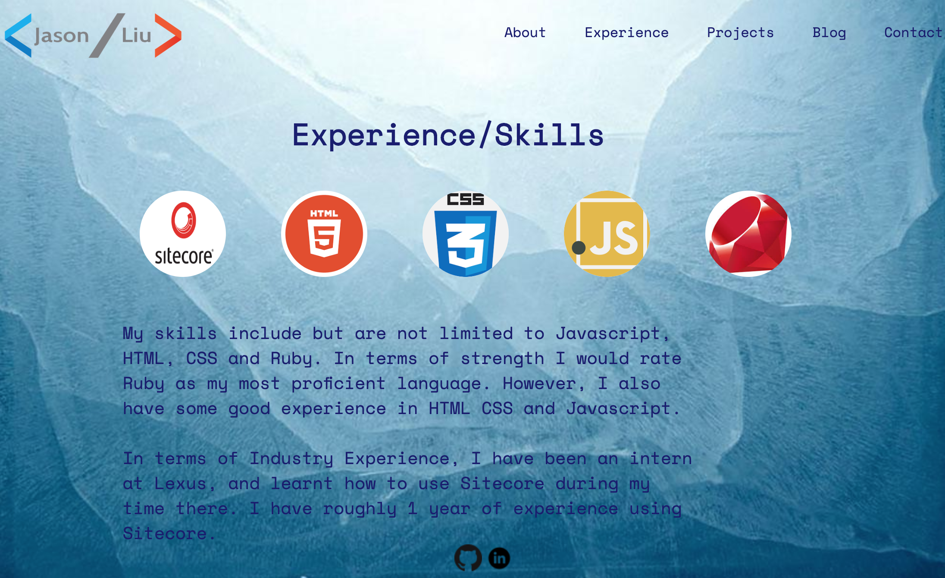
Experience/Skills Page
Heading
Logo
Navigation Bar
Icon
Content Container
Link

Slide 8
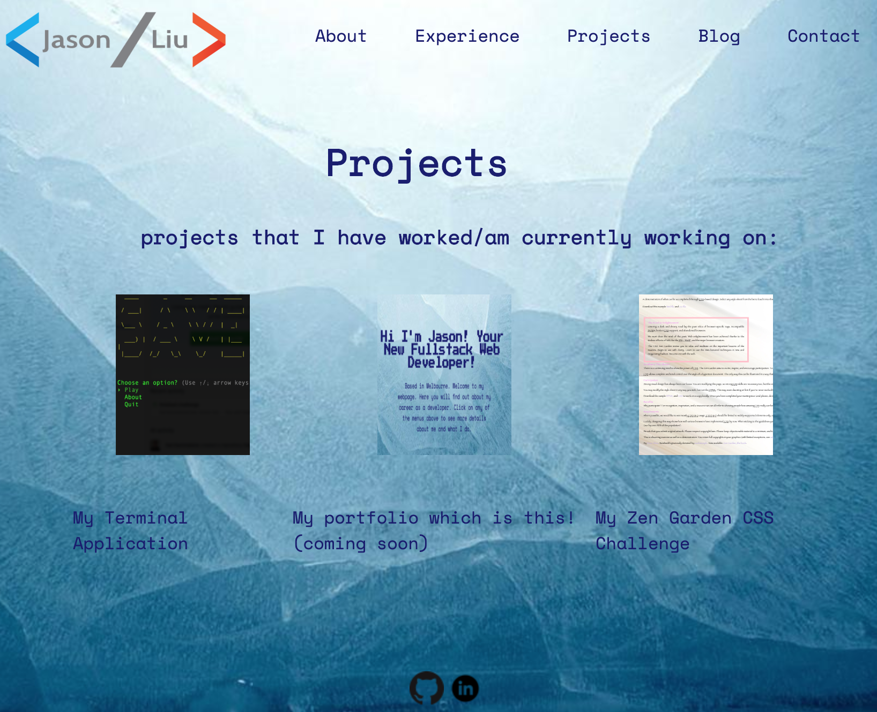
Projects Page
Navigation Bar
Logo
Heading
Content Container
Image
Link
Image
Link

Slide 9
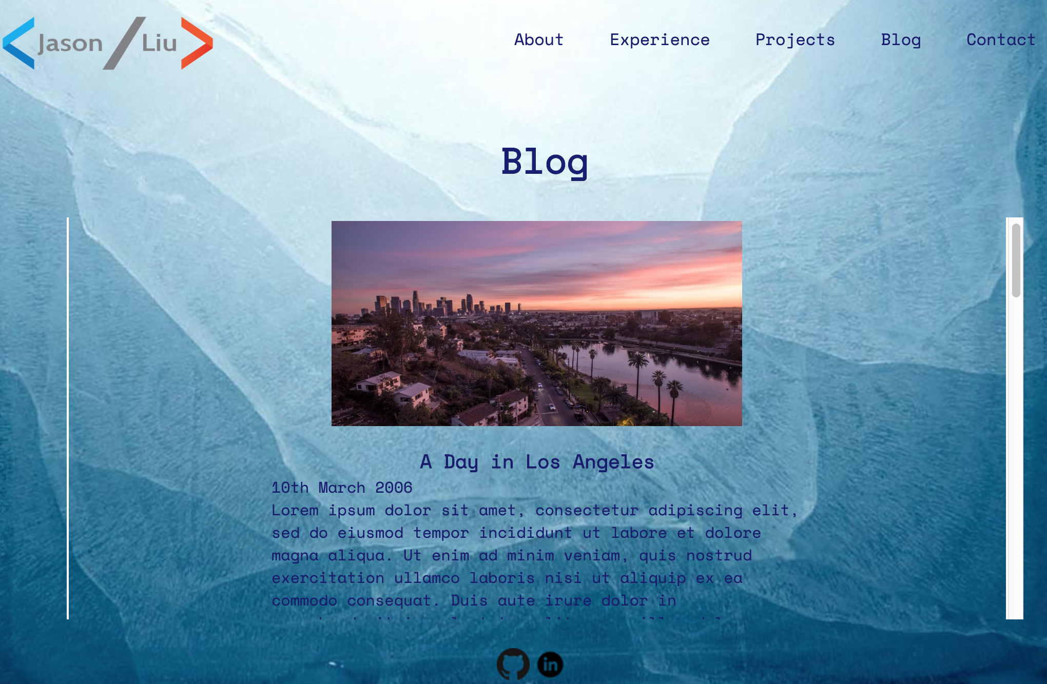
Blog Page
Logo
Navigation Bar
Heading
Scrollbar
Image
Content Container
Link

Slide 10
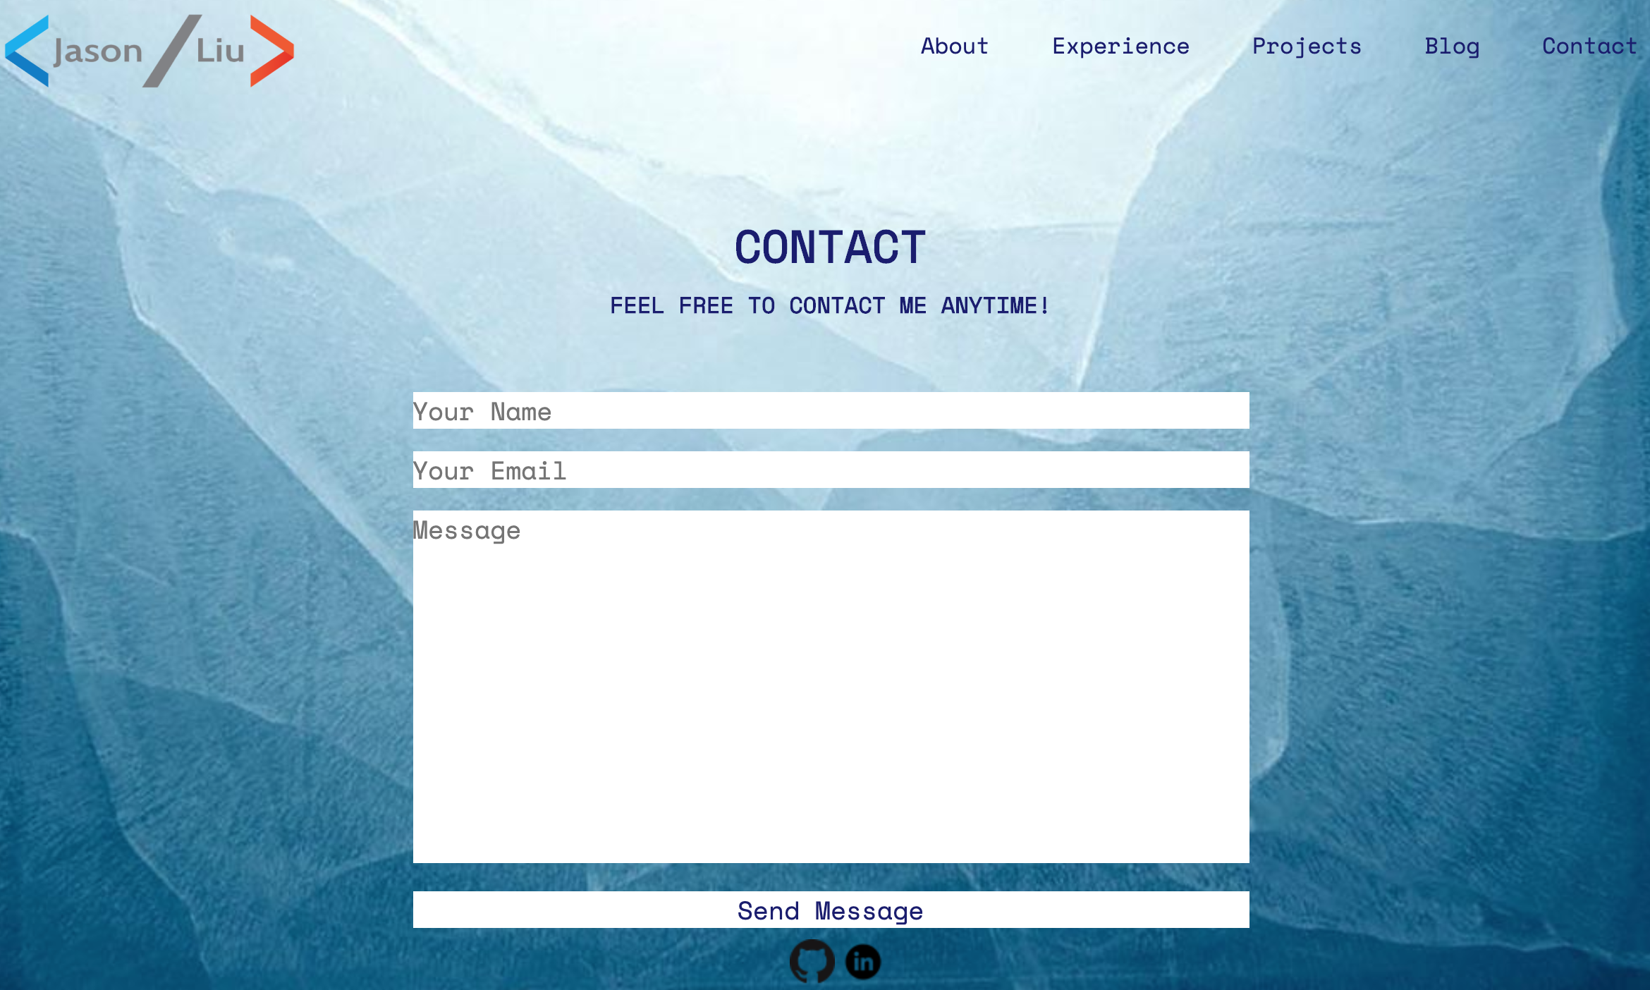
Contact Page
Logo
Navigation Bar
Heading
Forms
Link
Link

Slide 11
Thank you very much for watching!

